Slide 1

Software Architecture
SSE USTC Qing Ding
dingqing@ustc.edu.cn
http://staff.ustc.edu.cn/~dingqing

Slide 2

Distributed Architectures

Slide 3
Goals
Main goal: Scalability
In the optimal case a system scales linearly with the objective
E.g. number of transactions, size of the data, users

Slide 4
Solutions
Main solutions
More efficient algorithms
Use faster hardware (e.g. more powerful machines)
▶ Scale vertically
Add more machines
▶ Scale horizontally (scale out)
▶ Parallel computing, distributed computing

Slide 5
Distributed Architectures
Parallel computing vs. distributed computing
In parallel computing all component share a common memory, typically threads within a single program
In distributed computing each component has it own memory
▶ Typically in distributed computing the individual components are connected over a network
▶ Dedicated programming languages (or extensions) for parallel computing

Slide 6
Distributed Architectures
Distributed architectures
Most complex solution
▶ Due to the added parallelism of data and processing
▶ And therefore an increased risk of errors
Overall latency will be the the one of the slowest machine
▶ I.e. latency cannot be decreased via distributed solutions
Therefore the architecture needs to be sound
... focus on abstraction and composition
Note: In practice people are often biased towards technologies they know (e.g. SQL)

Slide 7
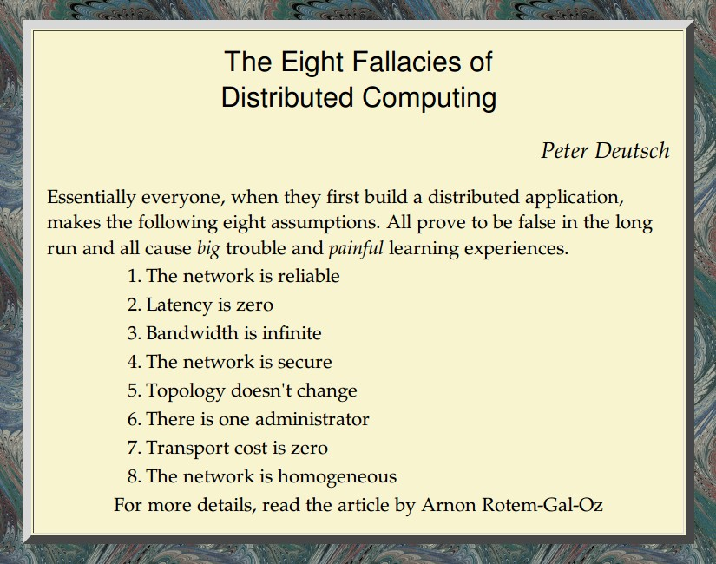
Distributed Architectures
http://nighthacks.com/roller/jag/resource/Fallacies.html

Slide 8
Distributed Architectures
Different levels of complexity
Lowest complexity for operations, which can easily be distributed
▶ If they are independent and short enough be to executed independent from each other
▶ And if the data can be partitioned into independent parts
Higher degree of complexity for operations, which compute a single result on multiple nodes
▶ Synchronisation of data access also raises the complexity

Slide 9
Distributed Architectures
Additional aspects of complexity
Complexity = intrinsic complexity + accidental complexity
▶ Intrinsic complexity of the problem itself (i.e. how hard is the problem)
▶ Accidental complexity arises from the implementation
▶ Low accidental complexity good for maintenance
▶ If high accidental complexity, you can never be sure it has been correctly implemented
▶ The risk of errors rises with the complexity (i.e. it scales)

Slide 10
Distributed Architectures - Practical Advise
General advice to deal with complexity
Design for failure
▶ E.g. hardware will fail, human errors (bugs)
▶ Limit their consequences
Push complexity into a single place
▶ Effect of bugs will be minimised
▶ Also called “complexity isolation”
Avoid tricky operations Avoid to store aggregates
▶ Prefer to deal with raw data
▶ Treat the data as immutable

Slide 11
Distributed Architectures - Theory
Locality of Reference
Granularity: CPU caches to storage position within the data centre In a distributed context: bring the code to the data
Best practice: position the data in a way it is accessed
▶ Partition the data according to some criteria
▶ e.g. Rack awareness of the computing infrastructure

Slide 12
Architecture for Simple Applications
Share Nothing Architecture No centralised data storage Can scale almost infinitely
Used since the beginning of the 80ies, popularised by Google Only a few systems allow for such an architecture
Implications
If a system requires some sort of shared resources or orchestrated processing, the complexity rises.

Slide 13
Distributed Architectures Basics
Building blocks of distributed systems

Slide 14
Distributed Architectures Basics
Number of issues to address
Serialisation
Group membership Leader election Distributed locks Barriers
Shared resources Configuration
1
2
3
4
5
6
7

Slide 15
Distributed Architectures Basics - Serialisation
Group serialisation
Transform an object into a byte array (and back)
▶ Needed to transfer objects between nodes in a distributed environment
▶ Used to store objects (e.g. in databases)
Should work across programming languages
Therefore serialisation frameworks provide a Schema Definition Language
Examples: Thrift, Protocol Buffers, Avro

Slide 16
Distributed Architectures Basics - Group Membership
Group membership
When a single node comes online... How does it know where to connect to?
How do the other members know of an added node?

Slide 17
Distributed Architectures Basics - Group Membership
⇒ Peer-to-peer architectural style Each node is client, as well as server Parts of the bootstrapping mechanism Dynamic vs. static
Fully dynamic via broadcast/multicast within local area networks (UDP)
Centralised P2P - e.g. central login components/servers Static lists of group members (needs to be configurable)

Slide 18
Distributed Architectures Basics - Leader Election
Leader election
Not all nodes are equal, e.g. centralised components in P2P networks Single node acts as master, others are workers
Some nodes have additional responsibilities (supernodes)
Having centralised components makes some functionality easier to implement
E.g. assign work-load
Disadvantage: might lead to a single point of failure

Slide 19
Distributed Architectures Basics - Leader Election
⇒ Client-server architectural style
Once the leader has been elected, it takes over the role of the server All other group members then act as clients

Slide 20
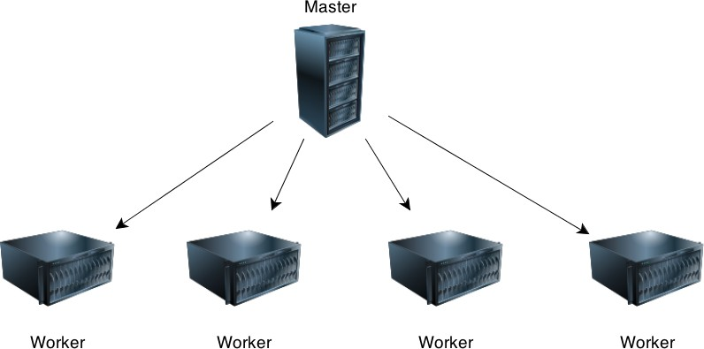
Distributed Architectures Basics - Leader Election

Slide 21
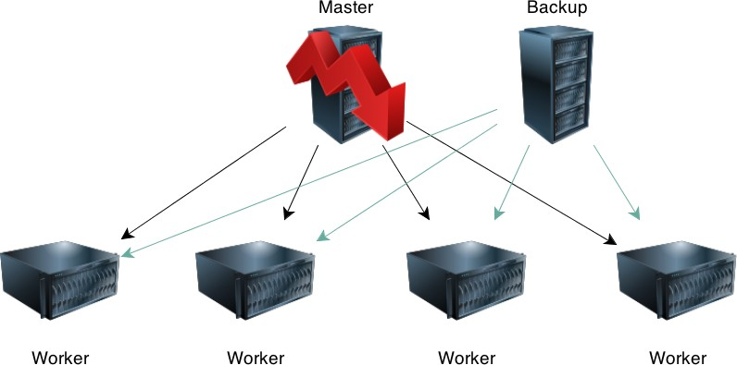
Distributed Architectures Basics - Leader Election

Slide 22
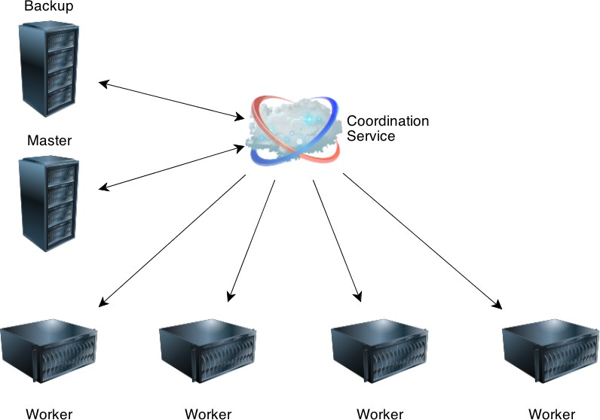
Distributed Architectures Basics - Leader Election

Slide 23
Distributed Architectures Basics - Locks
Distributed locks
Restrict access to shared resources to only a single node at a time
E.g. allow only a single node to write to a file
May yield many non-trivial problems, for example deadlocks or race conditions
Distributed locks without central component are very complex to realise

Slide 24
Distributed Architectures Basics - Locks
Distributed locks example
⇒ Blackboard architectural style
The shared repository is responsible to orchestrate the access to a locks
Notifies waiting nodes once the lock has been lifted
This functionality is often coupled with the elected leader

Slide 25
Distributed Architectures Basics - Barriers
Barriers
Specific type of distributed lock Sychronise multiple nodes
E.g. multiple nodes should wait until a certain state has been reached
Used when a part of the processing can be done in parallel and some parts cannot be distributed

Slide 26
Distributed Architectures Basics - Shared Resources
Shared Resources
If all nodes need to be able to access a common data-structure Read-only vs. read-write
If read-write, the complexity rises due to synchronisation issues

Slide 27
Distributed Architectures Basics - Zookeeper
Example: Apache Zookeeper Zookeeper is a framework/library Used by Yahoo!, LinkedIn, Facebook
Initially developed by Yahoo!, Now managed by Apache Features
▶ Coordination kernel
▶ File-system like API
▶ Synchronisation, Watches, Locks
▶ Configuration
▶ Shared data
Alternative approaches: Google Chubby, Microsoft Centrifuge

Slide 28
Distributed Architectures Basics - DFS
Distributed File Systems
Virtual file system distributed over multiple machines
▶ Based on a local file system
Same semantics like traditional file systems
▶ Folders & files
Files are internally split into smaller blocks (e.g. 64MB) Blocks are redundantly stored on multiple machines Logic to record, which block is stored on which machine

Slide 29
Distributed Architectures Basics - DFS
Examples of Distributed File Systems
Google File System (GFS)
▶ Based on a local file system
Hadoop Distributed File System (HDFS)
▶ Portable, open-source solution
▶ Consists of (a single) name node and (many) data nodes

Slide 30
Distributed Architectures Basics - Sharding
Sharding
Split the data horizontally
Each node in a network may manage a separate chunk of the data For example in web search engines
Each node is responsible for a number of web-pages Returns search results from the local collection
All results from all shards are then combined into a single result

Slide 31
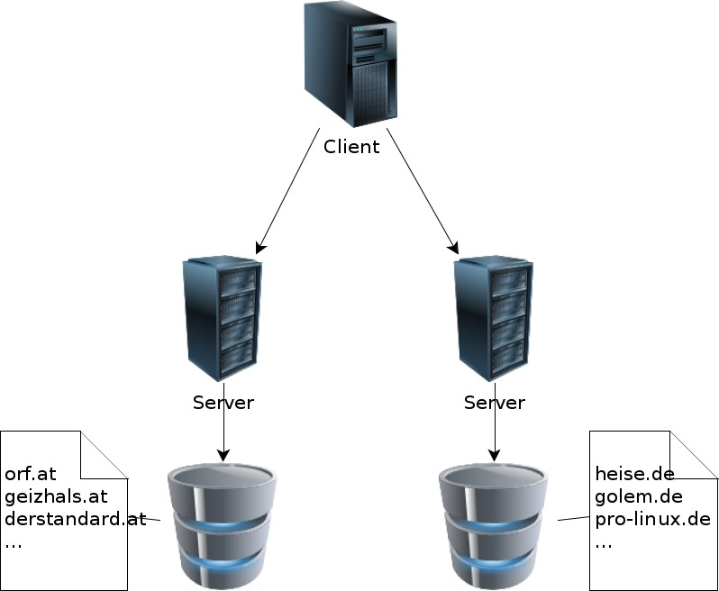
Distributed Architectures Basics - Sharding
Sharding example

Slide 32
Distributed Architectures Basics - Sharding
Sharding - Properties
Need redundancy, in case a node goes down Level of redundancy depends on the data
E.g. if a node with low-traffic web-pages goes down, it might not even have an impact on the quality of the search results (at least on the first page)

Slide 33
Distributed Architectures Basics - Quality Attribute
Anarchic Scalability
Design for a large distributed system
Parts of the system are developed independently from each other
Therefore the system need to be designed for malfunctioning or even maliciously components
The web is an example where anarchic scalability is one of the most important aspects
▶ Thus clients are not expected to know all servers
▶ ... and servers are not supposed to know all clients
▶ Another consequence is the link integrity → only one-directional

Slide 34
Asynchronous Architectures
The default choice for scalable solutions

Slide 35
Asynchronous Architectures - Motivation
Synchronous architectures
Each call terminates after the request has been completely processed
E.g. traditional data-centric architectures (databases) Pro: Easy to use and predictive behaviour
Con: Does not deal well with load (need to plan with the worst case)
Asynchronous architectures
The call returns before the request has been processed The processing happens in the background
Con: Non predictive behaviour
Pro: Load can be distributed over time, thus better scalability

Slide 36
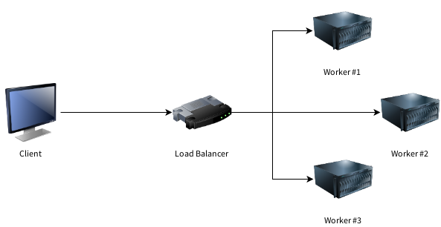
Asynchronous Architectures - Worker
Asynchronous worker architecture
The client issues a call without waiting for the result

Slide 37
Asynchronous Architectures - Worker
Asynchronous worker architecture
The client does not wait for the end of the processing
I.e. does not track the result
If the worker fails, all currently processed request will fail
Queue Motivation
Introduce a new component to track the processing of the requests, e.g. a queueing system

Slide 38
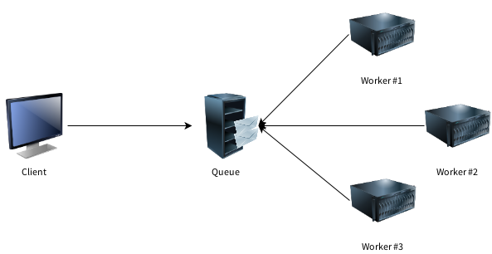
Asynchronous Architectures - Queue & Worker
Asynchronous queue & worker architecture
The client puts the request into the queue, the workers poll the queue for requests

Slide 39
Asynchronous Architectures - Queue & Worker
Queue and worker architecture
The client is decoupled from the worked via a queue component
The queue component is (usually) responsible to track the status of the requests
The size of the queue depends on the current load
If a worker fails, the request will be put back into the queue Default architecture choice for many distributed systems
Note: Often, the queue itself might be distributed and might store the requests (e.g. in a database)

Slide 40
Asynchronous Architectures - Queue & Worker
Queue and worker architecture aspects
The number of workers/applications may vary
▶ Single consumer vs. multi consumer queues
▶ Multiple independent workers that execute the same code vs.
▶ ... each worker has a different task
Typically queues are FIFO (first in, first out)
▶ Some queue support items with higher priority
In some configurations the application is responsible to track the status
A typical application may consist of multiple layers of queues and workers
▶ I.e. the output of a worker is fed as input to another queue

Slide 41
Asynchronous Architectures - Queue & Worker
Queue & worker properties
The architecture is straightforward, but not simple Race conditions may occur
Partitioning might be hard to implement
▶ Bad for fault tolerance
Tedious to build
▶ Much code necessary for serialisation/routing logic/monitoring of queues/etc.
Complex deployment for all workers and queues

Slide 42
Asynchronous Architectures - Stream processing
Stream processing
The queue & worker architecture can be used for stream processing
▶ Not suitable for real-time applications, due to delay from the queue
Continuous stream of incoming requests
▶ I.e. the queue is perpetually filled
▶ Often these reflect events in such settings

Slide 43
Asynchronous Architectures - Stream Processing
Two basic stream processing types
One-at-a-time
▶ Each event is processed individually
Micro-batch
▶ Multiple events are combined into a single batch

Slide 44
Asynchronous Architectures - Stream Processing
Basic execution semantics
At-least-once
▶ Each event is guaranteed to be executed
▶ But might be processed more often (thus the same result might be reported multiple times)
▶ Might introduce inaccuracies
At-most-once
▶ Each event is optionally executed, but no more than once
Exactly-once
▶ Each event is guaranteed to be executed only once

Slide 45
Asynchronous Architectures - Stream Processing
Trade-off between the stream processing types
One-at-a-time Micro-Batch
Lower Latency Higher Throughput
✓
✓
At-least-once semantic | ✓ | ✓
Exactly-once semantic | (sometimes) | ✓
Simpler programming model | ✓

Slide 46
Asynchronous Architectures - Stream Processing
Implications
Exactly-once can be achieved via strictly ordered processing
▶ Fully process an event before continuing
More efficient for micro-batches
▶ Multiple batches in parallel
▶ Need to store the batch-id of the last successfully processed batch

Slide 47
Asynchronous Architectures - Stream Processing
Strength Examples
High throughput Hadoop, Spark
Batch
One-at-a-time Micro-batch
Low latency Tradeoff
Storm Trident, Spark
Table: Comparison of the main distributed architectures

Slide 48
Lambda Architecture
Big Data Architecture

Slide 49
Lambda Architecture - Motivation
Target scenario
Large amount of data
▶ Too big for a single machine → distributed system
Data is continuously updated
▶ Mostly just additions, i.e. new data
Majority of operations are read-only
▶ Effectively, queries on the data

Slide 50
Lambda Architecture - Motivation
Typical solution
The typical solution would be a data-centric architecture
Data is stored in a distributed traditional RDBMS or noSQL databases Updates are written into the database (via transactions)
The queries are computed in a distributed manner, over all the data As some queries are too slow, they need to be precomputed
... and the precomputed results need to be updated (as soon a new data comes in)
Therefore this can also be called a incremental architecture
The incremental architecture is too complex, mainly because of i) the (distributed) transaction support and ii) the complex algorithms to merge the new data.

Slide 51
Lambda Architecture - Motivation
Target properties
Robustness & fault tolerance Scalability
Generalisation Extensibility Ad hoc queries
Minimal maintainance Debuggability

Slide 52
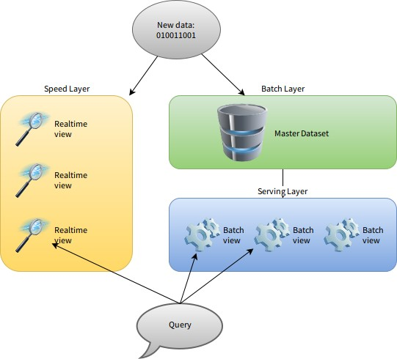
Lambda Architecture - Overview

Slide 53
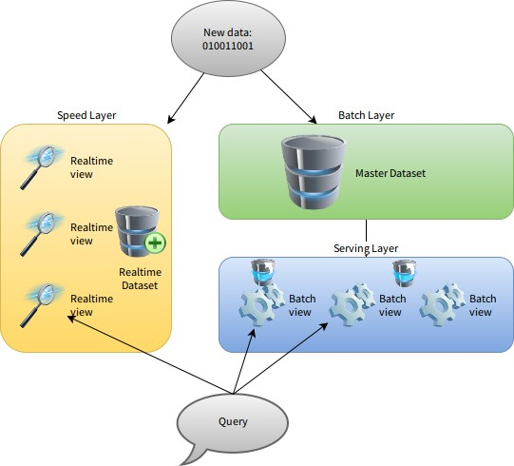
Lambda Architecture - Overview

Slide 54
Kappa Architecture
Simpler Alternative to Lambda Architecture

Slide 55
Kappa Architecture - Introduction
8 Rules of Stream Processing (Stonebraker et at., 2005)
Keep the Data Moving
Query using SQL on Streams (StreamSQL)
Handle Stream Imperfections (Delayed, Missing and Out-of-Order Data)
Generate Predictable Outcomes Integrate Stored and Streaming Data Guarantee Data Safety and Availability
Partition and Scale Applications Automatically Process and Respond Instantaneously

Slide 56
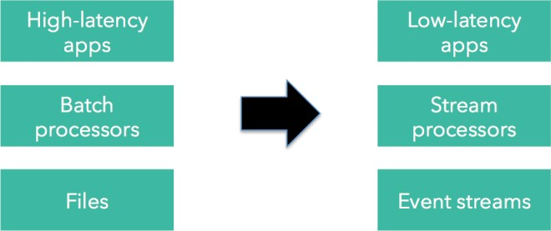
Kappa Architecture - Motivation
Basic idea behind Kappa Architecture
The Lambda Architecture is relatively complex
Most of the problems can be solved via a streaming approach
→ treat the batch processing as if it were a stream of data
▶ Have the framework optimise for the two cases (stream vs. batch)
http://www.kappa-architecture.com/

Slide 57
Kappa Architecture - Example
Example of streaming framework: Apache Kafka
Message queueing system
Stores all data for a given timespan, e.g. 2 days Topics
▶ Partitions within topics
▶ Partitions are chosen by the application, i.e. both producers and consumers need to agree on the partitions
Brocker
Each message within a partition has an offset Clients have a unique id and remember their offset

